Slide 1
Twizzler : a Data-Centric OS for Non-Volatile Memory
Bittman, Daniel., Alvaro, Peter., Pankaj Mehra., Darrell D. E. Long., & Ethan L. Miller.
In 2020 USENIX Annual Technical Conference
2020. 08. 10
Presentation by Han, Yejin
32164881@dankook.ac.kr
Notes:
Let me begin my presentation.
Today I will give a presentation on “Fully Automatic Stream Management for Multi-Streamed SSDs Using Program Contexts”

Slide 2
Introduction
Motivation
Twizzler
Evaluation
Conclusion
Notes:
This is the outline on my talk.
First, I will describe garbage Collection overhead in SSDs and Multi-Streamed SSD
Then, the details of PCStream design and analysis results are presented.
Finally, I will conclude my talk.

Slide 3
Contents
Introduction
Notes:
So, I will describe garbage Collection overhead in SSDs
As you all know, GC copies valid pages and reclaims free space. This results in write amplification, which has a significant impact on life and performance.
To reduce this overhead, a lot of research has been done in the past and there are examples A and B.

Slide 4
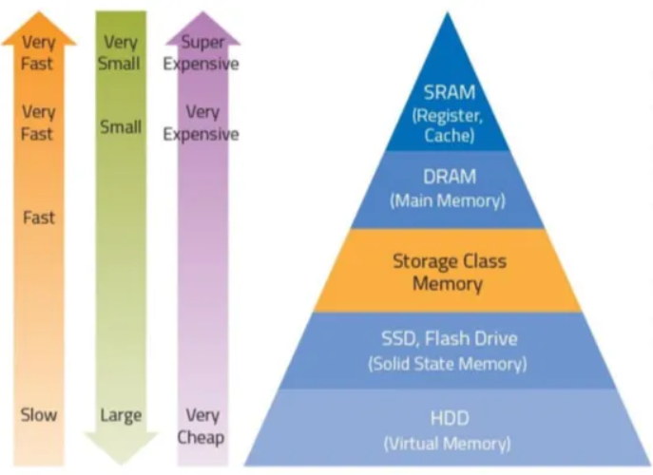
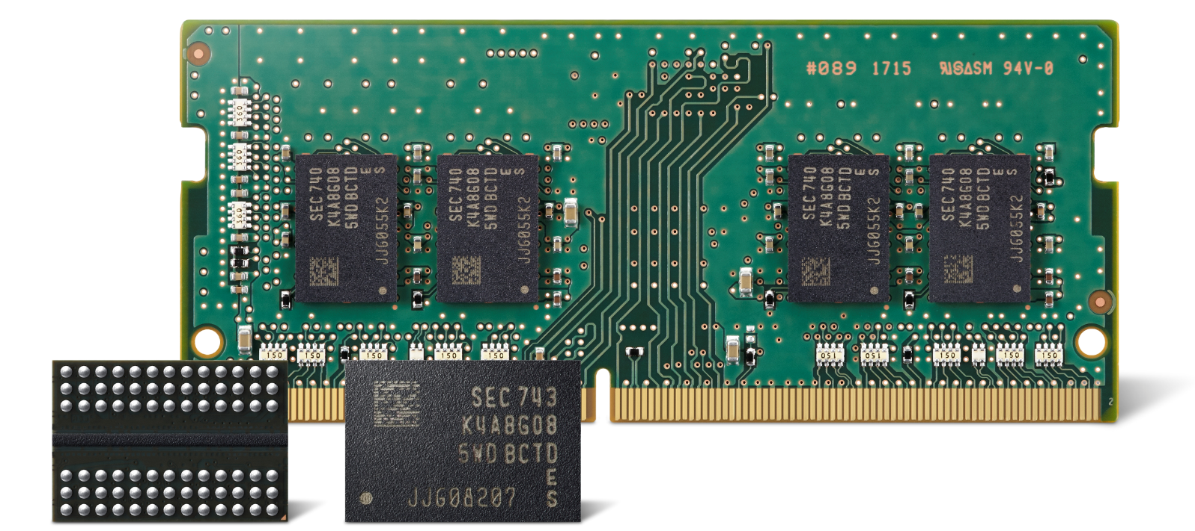

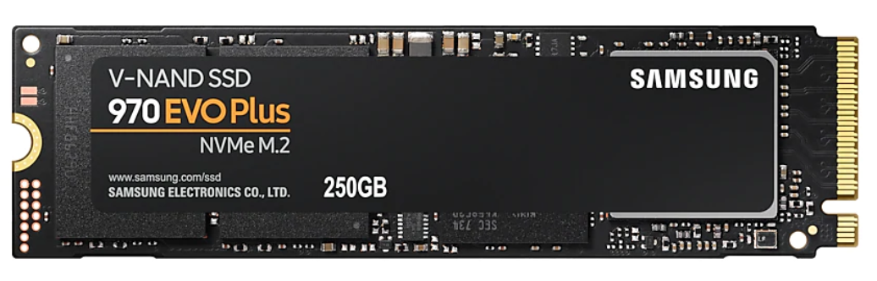
1. Introduction
Hardware Trends
Non-Volatile Memory
Capacity, Performance, Cost
DRAM
NVM
SSD
Notes:
NVM은 DRAM보다 용량이 크고 storage보다 속도가 빠르다. 영구적인 데이터를 접근할 때 메모리에 접근할 때처럼 byte단위로 접근이 가능하다 그래서 메모리와 스토리지 간의 페이지 블록 단위의 접근을 없앨 수 있다.

Slide 5
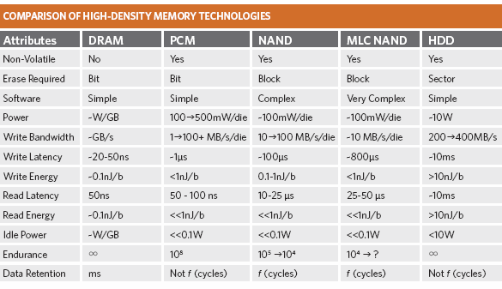
1. Introduction
NVM characteristics
Non-volatile
R/W Performance
Byte-addressable
Byte-addressable Yes Yes No
출처: https://research.cs.wisc.edu/sonar/wiki/pmwiki.php?n=Mnemosyne.PCMTechnology
Notes:
DRAM과 PCM, NAND간의 속도차이가 몇배가 나는지 설명

Slide 6
Contents
Motivation
Notes:
So, I will describe garbage Collection overhead in SSDs
As you all know, GC copies valid pages and reclaims free space. This results in write amplification, which has a significant impact on life and performance.
To reduce this overhead, a lot of research has been done in the past and there are examples A and B.

Slide 7
2. Motivation
CPU
store
load
Two-tier memory hierarchy
Kernel
Main Memory
write
read
Storage
Notes:
커널 개입을 여기서 써야하는가..?
동기: NVM을 잘 써야한다.

Slide 8
2. Motivation
CPU
store
load
CPU
Two-tier memory hierarchy
load
store
Kernel
load
store
Main Memory
Kernel
Single level Interface
Serialization
write
read
Main Memory
NVM
Deserialization
Storage
Notes:
기존에는 OS가 메모리로의 데이터 copy, storage로의 영구 데이터 연산(read/write)를 직접 개입함-> 속도낮아짐

Slide 9
2. Motivation
CPU
store
load
CPU
Two-tier memory hierarchy
load
store
Kernel
load
store
Main Memory
Kernel
Single level Interface
Serialization
write
read
Main Memory
NVM
Deserialization
Storage
Byte-addressable
Block-addressable
Why?
Persistent data should be operated on directly and like memory
Notes:
커널 개입을 여기서 써야하는가..?
동기: NVM을 잘 써야한다.

Slide 10
Contents
Twizzler
Notes:
So, I will describe garbage Collection overhead in SSDs
As you all know, GC copies valid pages and reclaims free space. This results in write amplification, which has a significant impact on life and performance.
To reduce this overhead, a lot of research has been done in the past and there are examples A and B.

Slide 11
3. Twizzler
Twizzler’s goals
Little kernel involvement
Low overhead
Support for security and sharing
Notes:
기존 OS는 NVM을 효과적으로 이용할 수 없다.

Slide 12
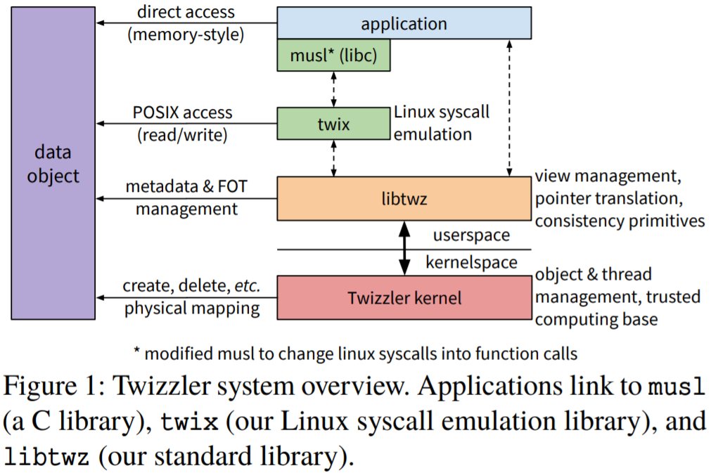
3. Twizzler
Library OS
Design
Object Management
Address space Management
Persistent Pointers
Open-Source
Notes:
So, I will describe garbage Collection overhead in SSDs
As you all know, GC copies valid pages and reclaims free space. This results in write amplification, which has a significant impact on life and performance.
To reduce this overhead, a lot of research has been done in the past and there are examples A and B.

Slide 13
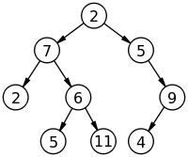
3. Twizzler
Object Management
Twizzler organizes data into objects
Twizzler uses objects as the unit of access control
- Read/Write/Execute Permissions(MMU)
Objects are created/deleted by the create/delete system call
Application
Twizzler
NVM
Object
create
Object
Object ID
(128 bit)
return

Slide 14
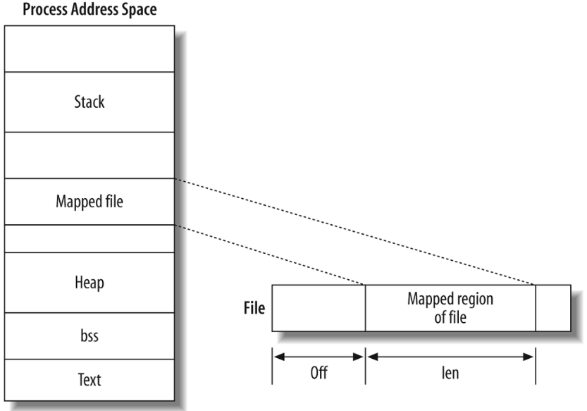
3. Twizzler
Address Space Management
Twizzler maps persistent objects into the VA space via libtwz
Kernel and user-space share a view that defines an AS layout
Process N
Object
Object
Object
Object A
Object B
View N
mmap(sys_call)
libtwz(library)
User
User
view
View(Object)
Addr 100 | Object ID
Addr 108 | Object ID
Kernel
Kernel
File system
No File system
SSD
NVM
Object
Notes:
Memory mapped I/O mmap I/O

Slide 15
3. Twizzler
Address Space Management
Twizzler maps persistent objects into the VA space via libtwz
Kernel and user-space share a view that defines an AS layout
Process N
Object
Object
Object A
Object B
View N
mmap(sys_call)
libtwz(library)
User
User
view
View(Object)
Addr 100 | Object ID
Addr 108 | Object ID
Kernel
Kernel
File system
How?
No File system
SSD
NVM
Object
Notes:
Memory mapped I/O mmap I/O

Slide 16
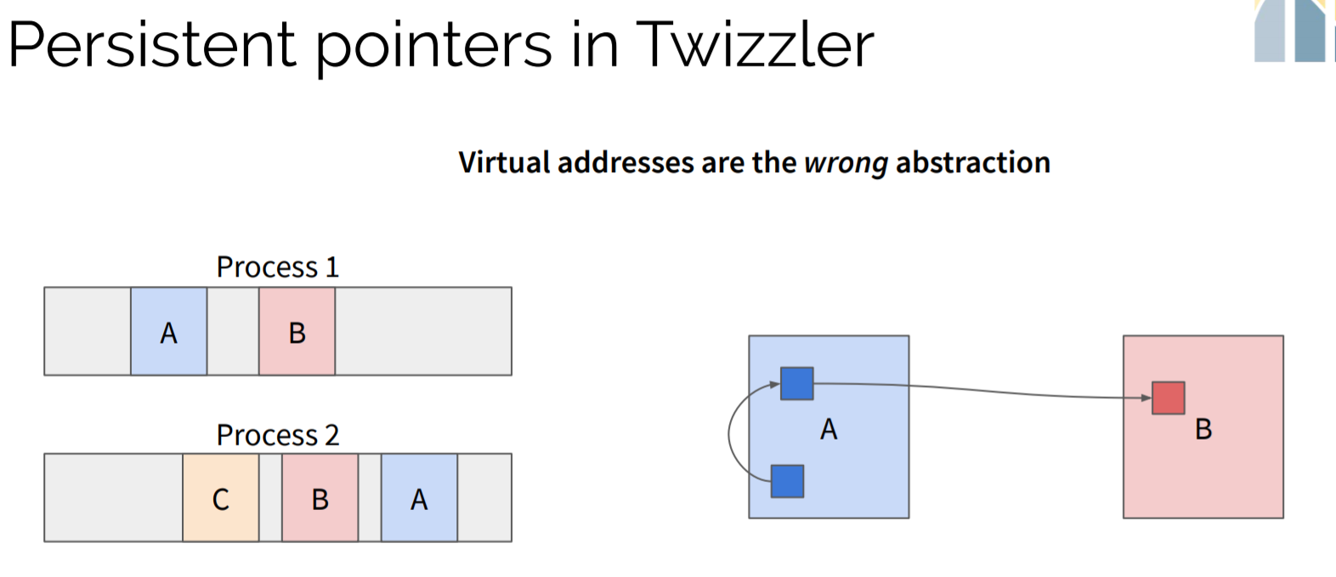
3. Twizzler
Persistent Pointers
Kerne
Notes:
So, I will describe garbage Collection overhead in SSDs
As you all know, GC copies valid pages and reclaims free space. This results in write amplification, which has a significant impact on life and performance.
To reduce this overhead, a lot of research has been done in the past and there are examples A and B.

Slide 17
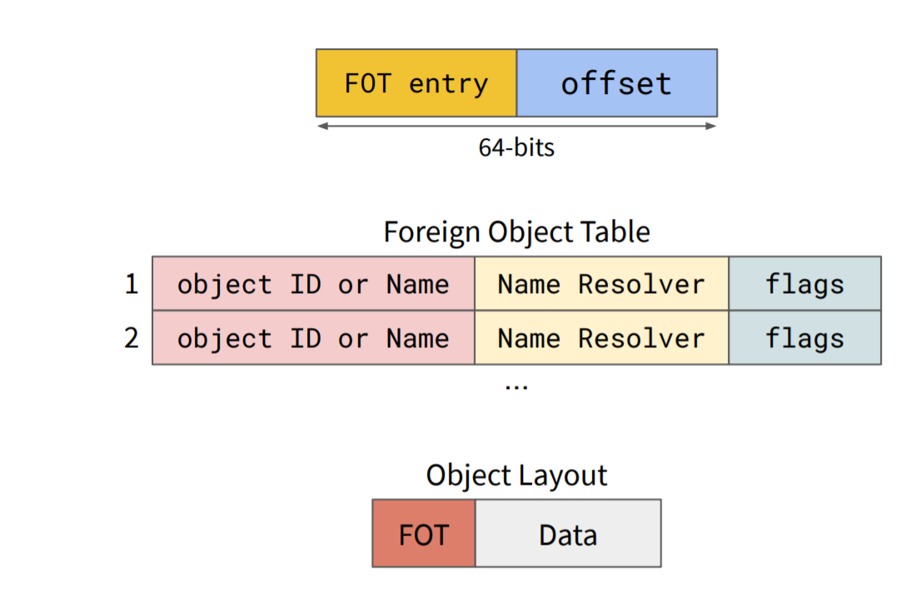
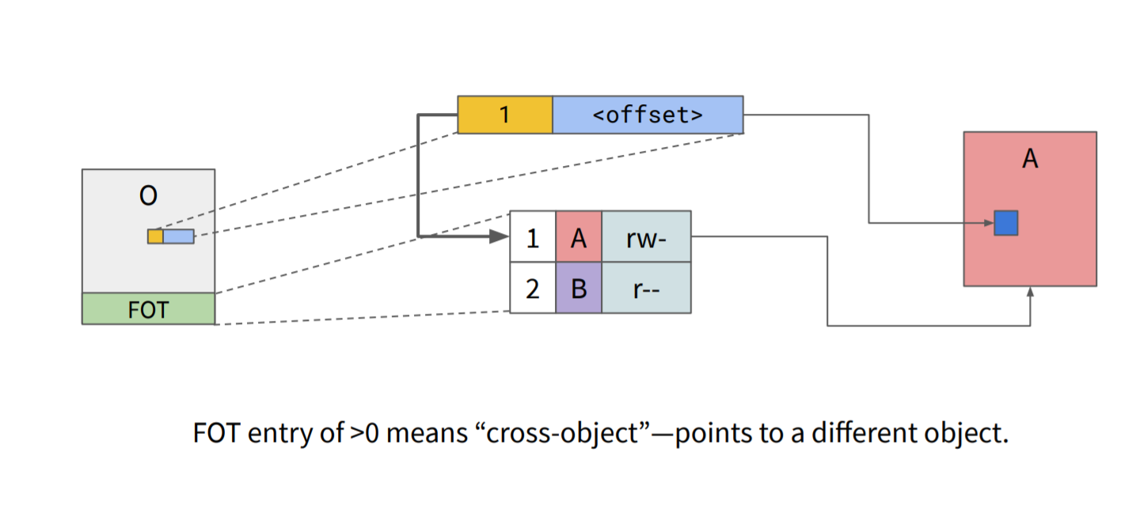
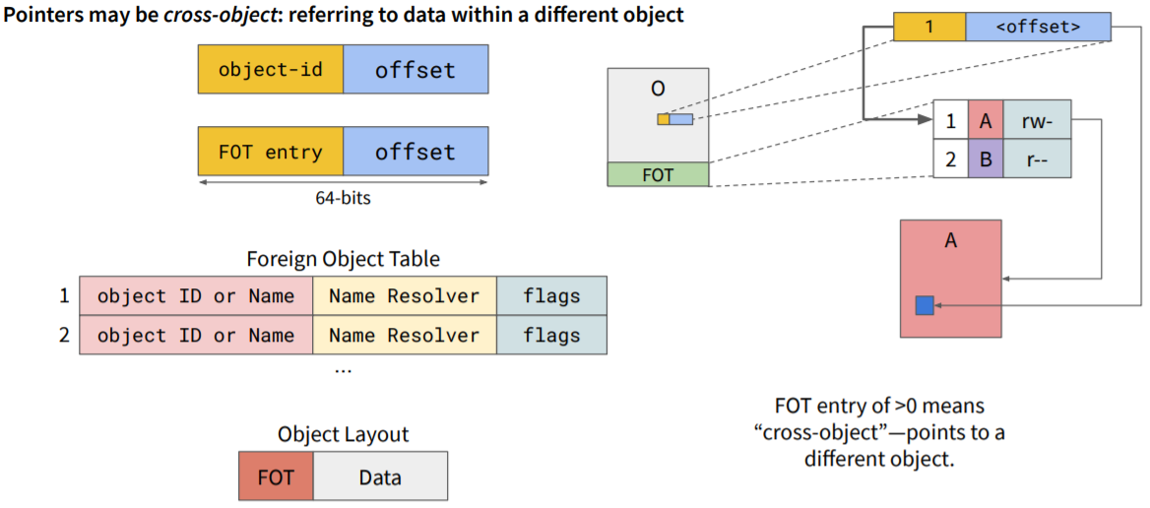

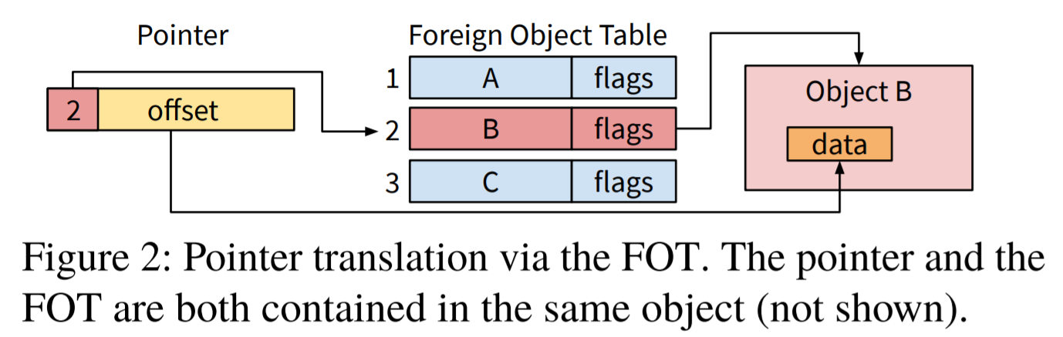
3. Twizzler
Persistent Pointers
Kerne
Notes:
So, I will describe garbage Collection overhead in SSDs
As you all know, GC copies valid pages and reclaims free space. This results in write amplification, which has a significant impact on life and performance.
To reduce this overhead, a lot of research has been done in the past and there are examples A and B.

Slide 18
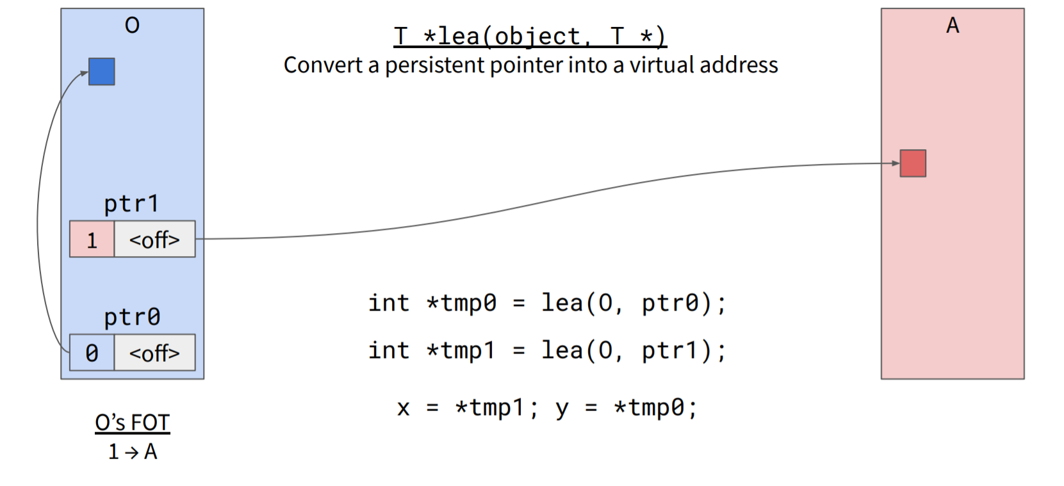
3. Twizzler
Persistent Pointers
Kerne
Notes:
So, I will describe garbage Collection overhead in SSDs
As you all know, GC copies valid pages and reclaims free space. This results in write amplification, which has a significant impact on life and performance.
To reduce this overhead, a lot of research has been done in the past and there are examples A and B.

Slide 19
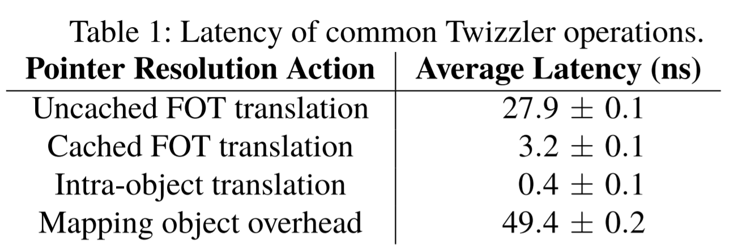
3. Twizzler
Persistent Pointers
Mircrobenchmark
Notes:
So, I will describe garbage Collection overhead in SSDs
As you all know, GC copies valid pages and reclaims free space. This results in write amplification, which has a significant impact on life and performance.
To reduce this overhead, a lot of research has been done in the past and there are examples A and B.

Slide 20
Contents
Evaluation
Notes:
So, I will describe garbage Collection overhead in SSDs
As you all know, GC copies valid pages and reclaims free space. This results in write amplification, which has a significant impact on life and performance.
To reduce this overhead, a lot of research has been done in the past and there are examples A and B.

Slide 21
4. Evaluation
Primary goals for evaluating Twz
Show that Twizzler meets the needs of a data-centric OS
- enabling programs to directly access persistent data
Demonstrate that the programming model provides sufficient power
- easily and effectively build real applications with NVM in mind
Measure the performance of our system
- understand where we gain and lose performance
Notes:
So, I will describe garbage Collection overhead in SSDs
As you all know, GC copies valid pages and reclaims free space. This results in write amplification, which has a significant impact on life and performance.
To reduce this overhead, a lot of research has been done in the past and there are examples A and B.

Slide 22
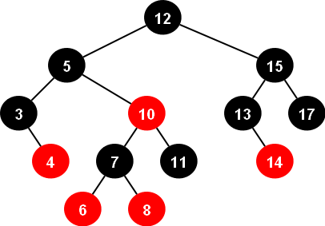

4. Evaluation
Case Study
1) Key-Value Store 2) Red-Black Tree 3)SQLite

Slide 23
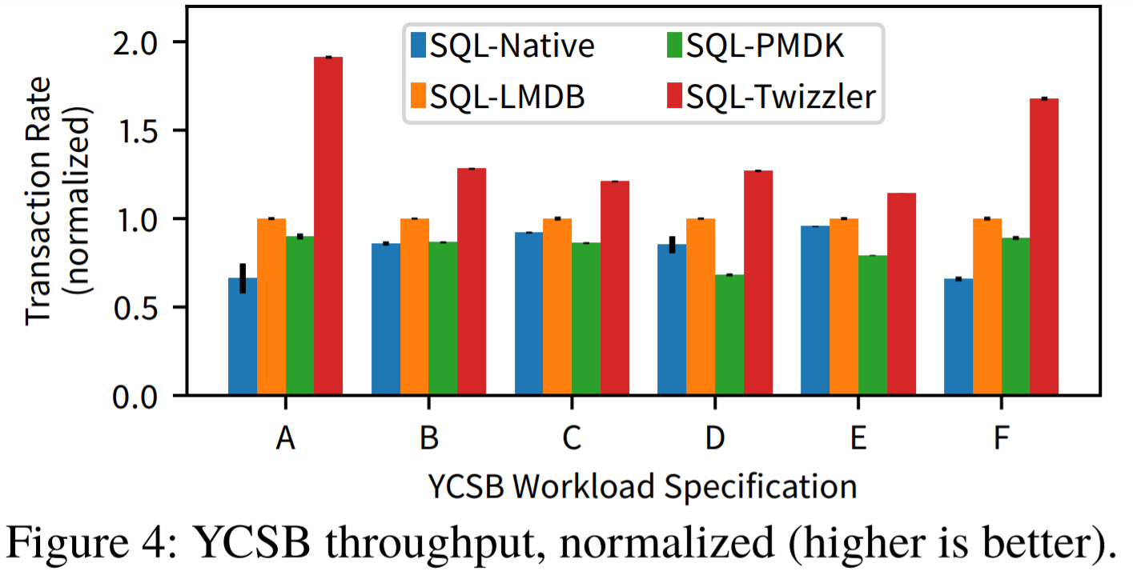
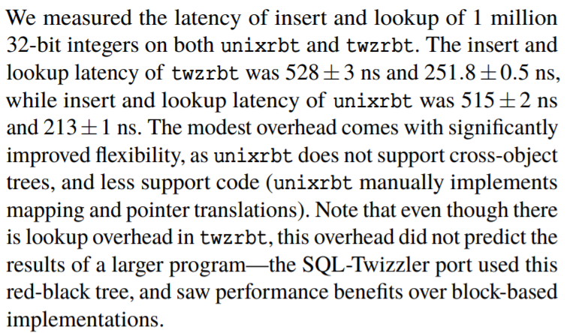
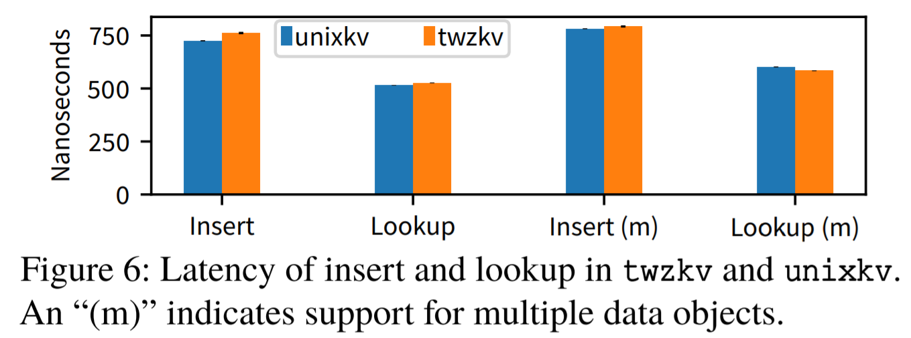
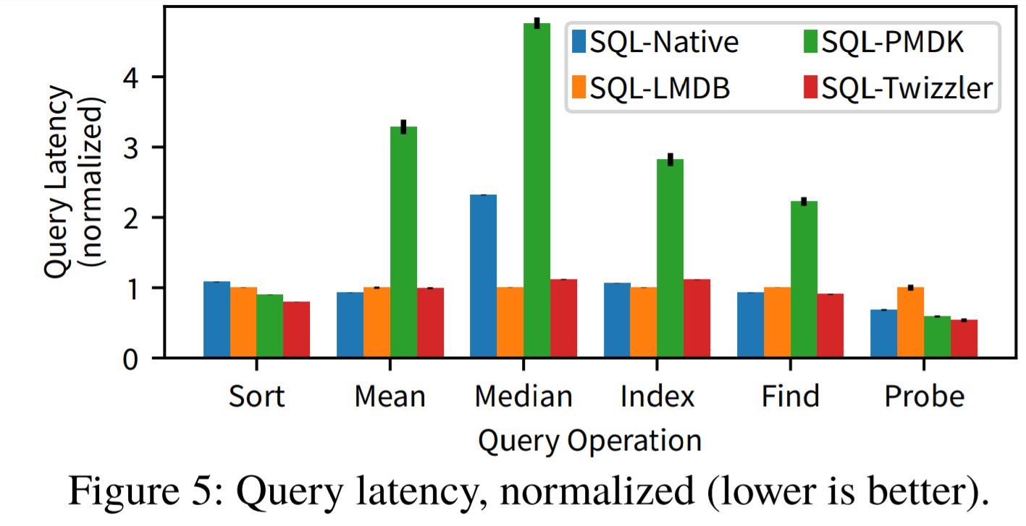
4. Evaluation
Performance
1) Key-Value Store 2) Red-Black Tree 3)SQLite
Notes:
So, I will describe garbage Collection overhead in SSDs
As you all know, GC copies valid pages and reclaims free space. This results in write amplification, which has a significant impact on life and performance.
To reduce this overhead, a lot of research has been done in the past and there are examples A and B.

Slide 24
Contents
Conclusion
Notes:
So, I will describe garbage Collection overhead in SSDs
As you all know, GC copies valid pages and reclaims free space. This results in write amplification, which has a significant impact on life and performance.
To reduce this overhead, a lot of research has been done in the past and there are examples A and B.

Slide 25
5. Conclusion
OS must evolve to support future trends in memory hierarchy organization.
Twizzler is an OS designed around NVM for direct access to memory.
Low overhead by removing the kernel from persistent data access path

Slide 26
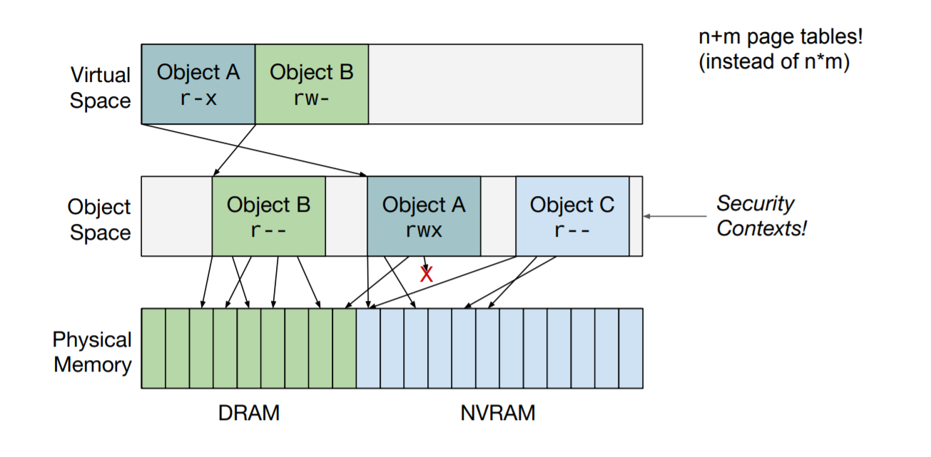
Appendix
Security and Access Control
Crash Consistency
Notes:
So, I will describe garbage Collection overhead in SSDs
As you all know, GC copies valid pages and reclaims free space. This results in write amplification, which has a significant impact on life and performance.
To reduce this overhead, a lot of research has been done in the past and there are examples A and B.

